Slide 1

Testing scientific code Because you’re worth it
Pietro Berkes and Lisa Schwetlick

Slide 2

You, as the Master of Research
You start a new project and identify a number of possible leads.
You quickly develop a prototype of the most promising ones; once a prototype is finished, you can confidently decide whether it is is a dead end, or worth pursuing.
Once you find an idea on which it is worth spending energy, you take the prototype and easily re-organize and optimize it so that it scales up to the full size of your problem.
As expected, the scaled-up experiment delivers good results, and your next paper is under way.

Slide 3

How to reach enlightenment
How do we get to the blessed state of confidence and efficiency?
Being a Python expert is not sufficient, good programming practices make a big difference
We can learn a lot from the development methods developed for commercial and open source software
Notes:
Me: Java during studies, in neuroscience everybody assumed I could use Matlab, luckily I had some Python background

Slide 4
Outline
The agile programming cycle
Testing scientific code basics
Testing patterns for scientific code
Continuous Integration

Slide 5
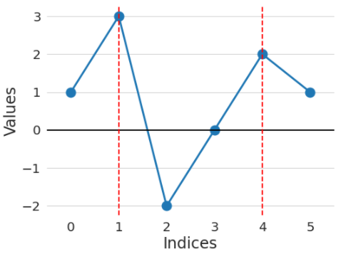
Warm-up project
Go to the directory called hands_on/local_maxima
In the file called local_maxima.py, write a function find_maxima that finds the indices of local maxima in a list of numbers
For example, find_maxima([1, 3, -2, 0, 2, 1]) should return [1, 4]

Slide 6
Warm-up project
Write a function find_maxima that finds the indices of local maxima in a list of numbers
Check your solution with these inputs:
Input: [1, 3, -2, 0, 2, 1] Expected result: [1, 4]
Input: [4, 2, 1, 3, 1, 5] Expected result: [0, 3, 5]
Input: [] Expected result: []
Input: [1, 2, 2, 1] Expected result: [1] (or [2], or [1, 2])
Input: [1, 2, 2, 3, 1] Expected result: [3]

Slide 7

The agile programming cycle

Slide 8

The agile development cycle
Write tests to check that feature works
Write simplest code that makes tests pass
Run tests and debug until all tests pass
Refactor and optimize only if necessary
Pick your next feature
Notes:
As opposed to waterfall model
Reminder
1) describe cycle
2) short development cycles: granularity of chosen feature is important
3) for all of these steps there are python tools to help you; there’s no tool yet for writing the code, unfortunately

Slide 9
Python tools for agile development
Write tests to check that feature works
Write simplest code that makes tests pass
Run tests and debug until all tests pass
Refactor and optimize only if necessary
Pick your next feature
pytest
pdb
timeit
cProfile
line_profiler
Notes:
3) for all of these steps there are python tools to help you; there’s no tool yet for writing the code, unfortunately

Slide 10

Why test scientific code?

Slide 11
Why write tests? Confidence and correctness
Confidence:
Write the code once and use it confidently everywhere else: avoid the negative result effect!
Correctness:
Correctness is main requirement for scientific code
You must have a strategy to ensure correctness

Slide 12
Effect of software bugs in science
frequency
bug severity
oops, wrong labels!
need to send errata corrige
end of career
Notes:
Made up plot, not backed by any data; and no error bars!
This slide is supposed to scare you into listening to the rest
didn’t properly shuffle my data for the control, a couple of results are not statistically significant any more… errata

Slide 13
The unfortunate story of Geoffrey Chang
Science, Dec 2006: 5 high-profile retractions (3x Science, PNAS, J. Mol. Biol.) because ”an in-house data reduction program introduced a change in sign for anomalous differences”
Notes:
When you get a crappy result, you triple check your code for bugs. If the results come out just the way you want them to, how much effort are you going to put into double-checking?
For two errors reported and retraced, many more undetected or not reported.

Slide 14

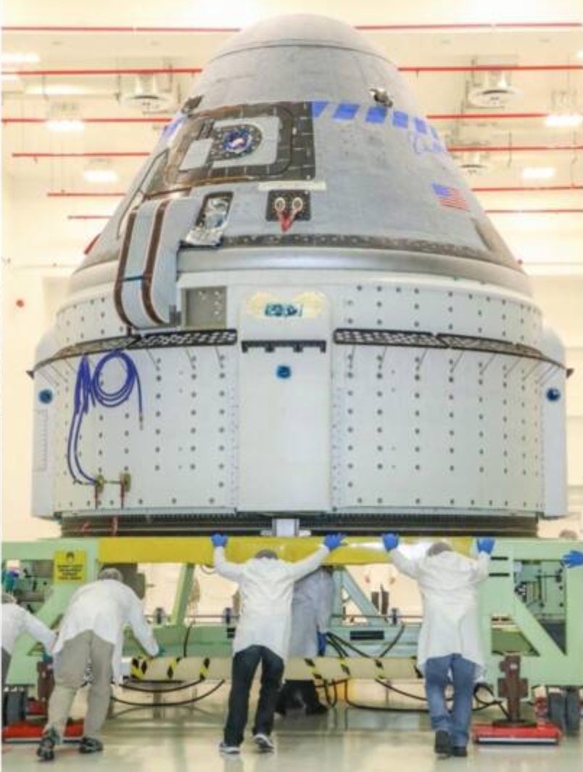
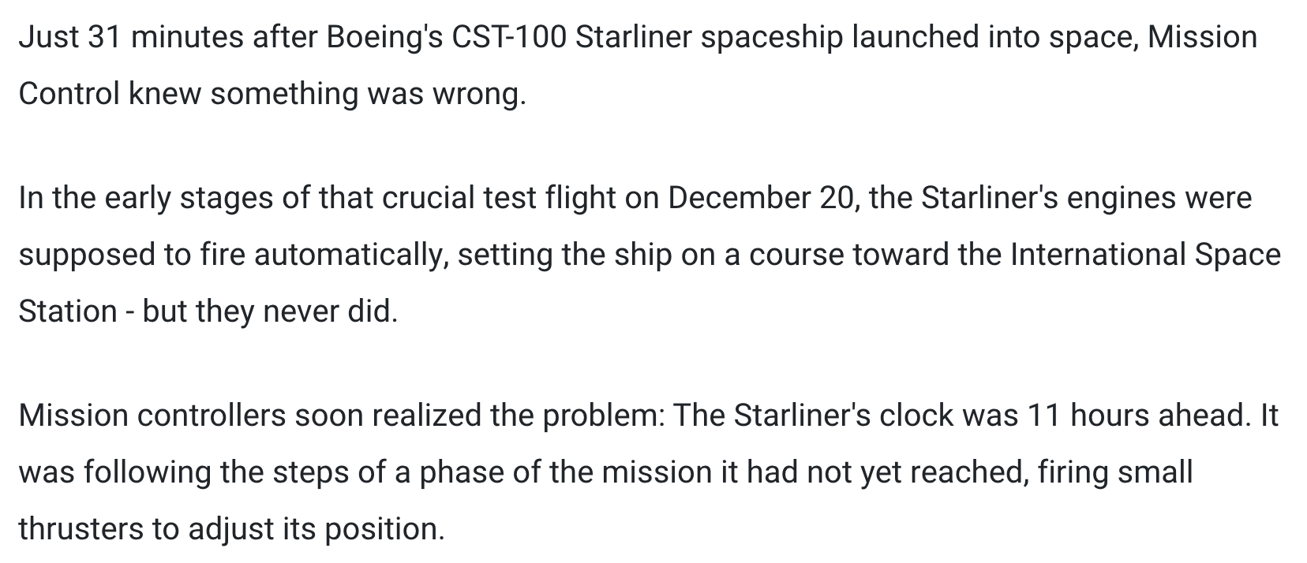
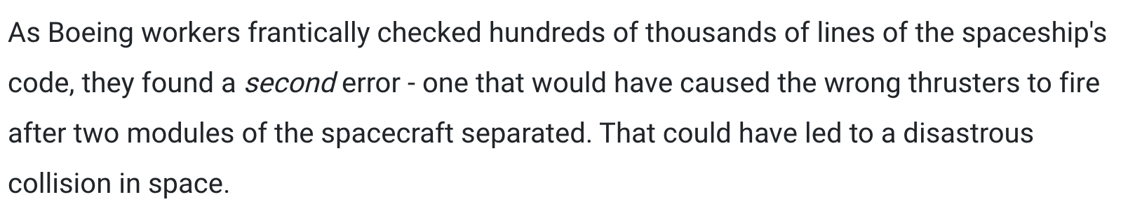
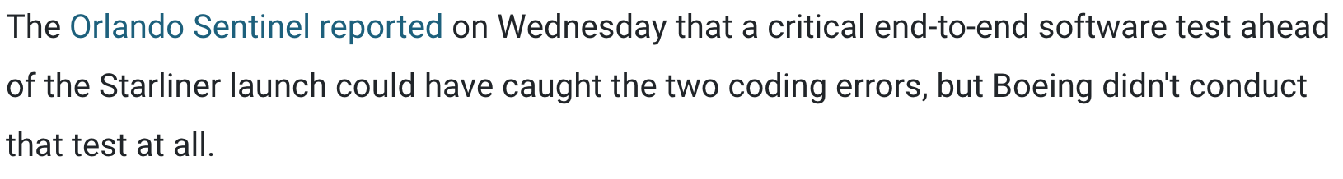
[...]
https://www.businessinsider.fr/us/boeing-software-errors-jeopardized-starliner-spaceship-737-max-planes-2020-2

Slide 15

Testing basics

Slide 16
A test is just another function
Imagine we wrote this new function, and we want to test it
def times_3(x):
"""Multiply x by 3.
Parameters
----------
x : The item to multiply by 3.
"""
return x * 3

Slide 17
Testing frameworks
The collection of tests written to test a package is called a “test suite”
Execution of a test suite is automated: external software runs the tests and provides reports and statistics
Main testing frameworks for python:
unittest: in the standard library
pytest: what is most commonly used
=============================================== test session starts ================================================
platform darwin -- Python 3.11.3, pytest-7.3.1, pluggy-1.0.0
collected 2 items
test_first.py::test_times_3_integer PASSED [ 50%]
test_first.py::test_times_3_string PASSED [100%]
================================================ 2 passed in 0.00s =================================================
Notes:
everybody “tests” his software, little toy problems, or just run it and use it for a while and see than nothing breaks

Slide 18
Hands-on!
Go to hands_on/first
Discover all tests in all subdirectories pytest -v
Execute all tests in one module pytest -v test_first.py
Execute one single test pytest -v test_first.py::test_times_3_string
Notes:
PyAnno: describe context a little bit; how are annotations represented
Show directory structure
Open file, comment on content
Show next slide: all the ways to execute a test

Slide 19
Test suites in Python with pytest
Writing tests with pytest is simple:
Tests are collected in files called test_abc.py , and usually it contains tests for the functions defined in a corresponding module abc
Each test is a function called test_jkl_feature, and usually it tests feature feature of a function called jkl
Each test tests one feature in your code, and checks that it behaves correctly using “assertions”. An exception is raised if it does not work as expected.

Slide 20
Assertions
assert statements check that some condition is met, and raise an exception otherwise
Check that statement is true/false: assert 'Hi'.islower() => fail assert not 'Hi'.islower() => pass
Check that two objects are equal: assert 2 + 1 == 3 => pass assert [2] + [1] == [2, 1] => pass assert 'a' + 'b' != 'ab' => fail
assert can be used to compare all sorts of objects, and py.test will take care of producing an approriate error message

Slide 21
Hands-on! Possibly your first test
Inside test_first.py, test that first([1]) returns what you would expect
Try to change the expected result to [2] (or anything you want) and watch the test break. Look at the error message and make sure you understand what’s going on
Notes:
Import unittest
Define a test unit as a subclass of TestCase
Define a series of methods beginning with ‘test_’ that test some aspect of the code
When unittest.main() is called, the method automatically finds the tests and executes them one by one giving back a report

Slide 22
Hands-on!
Create a new file, test_plus.py: test that 1+2 is 3
Execute the tests
Then write a new test and check that 1.1 + 2.2 is 3.3
Execute the tests

Slide 23
Floating point equality
Real numbers are represented approximately as “floating point” numbers. When developing numerical code, we have to allow for approximation errors.
Check that two numbers are approximately equal: from math import isclose def test_floating_point_math(): assert isclose(1.1 + 2.2, 3.3) => pass
abs_tol controls the absolute tolerance: assert isclose(1.121, 1.2, abs_tol=0.1) => pass assert isclose(1.121, 1.2, abs_tol=0.01) => fail
rel_tol controls the relative tolerance: assert isclose(120.1, 121.4, rel_tol=0.1) => pass assert isclose(120.4, 121.4, rel_tol=0.01) => fail
Notes:
If you’re working with floating point numbers two number are rarely exactly the same

Slide 24
Hands-on!
One more equality test: check that the sum of these two NumPy arrays: x = np.array([1, 1]) y = np.array([2, 2]) is equal to z = np.array([3, 3])

Slide 25
Testing with numpy arrays
def test_numpy_equality(): x = np.array([1, 1]) y = np.array([2, 2]) z = np.array([3, 3]) assert x + y == z
__________________________________ test_numpy_equality __________________________________
def test_numpy_equality():
x = numpy.array([1, 1])
y = numpy.array([2, 2])
z = numpy.array([3, 3])
> assert x + y == z
E ValueError: The truth value of an array with more than one element is ambiguous. Use a.any() or a.all()
code.py:47: ValueError
Notes:
The intention was to test for equality element-by-element

Slide 26
Testing with numpy arrays
The module np.testing defines helper functions: assert_equal(x, y) assert_allclose(x, y, rtol=1e-07, atol=0)
If you need to check more complex conditions:
np.all(x): returns True if all elements of x are true np.any(x): returns True is any of the elements of x is true
combine with logical_and, logical_or, logical_not: # test that all elements of x are between 0 and 1 assert all(logical_and(x > 0.0, x < 1.0))
Notes:
The right way to do this is using …
If you need to check more complex conditions
allclose:
The tolerance values are positive, typically very small numbers. The
relative difference (`rtol` * abs(`b`)) and the absolute difference
`atol` are added together to compare against the absolute difference
between `a` and `b`.

Slide 27
Watch out for nans!
In general, nan is not equal to itself (IEEE standard)
assert_equal and assert_allclose consider nans equal by default
In [2]: np.nan == np.nan
Out[2]: False
def test_allclose_with_nan():
x = np.array([1.1, np.nan])
y = np.array([2.2, np.nan])
z = np.array([3.3, np.nan])
assert_allclose(x + y, z)
test_numpy_equality.py::test_allclose_with_nan PASSED

Slide 28
Write a working version of find_maxima, with testing
Read carefully the description of Issue #1 on GitHub
Submit a Pull Request for Issue #1
Fork the repository (if you haven’t already)
Create a new branch on the fork called, e.g., fix-1
Solve the issue with one or more commits
Push the branch to your GitHub fork
On GitHub, go to “Pull Requests” and open a pull request against branch main of the official ASPP repository
In the PR description write “Fixes #1” somewhere, this is going to create an automatic link to the issue, and close the issue if the PR is merged

Slide 29

Up next: Testing patterns

Slide 31
Testing error control
Check that an exception is raised: from py.test import raises def test_raises(): with raises(SomeException): do_something() do_something_else()
For example: with raises(ValueError): int('XYZ’) passes, because int('XYZ’) ValueError: invalid literal for int() with base 10: 'XYZ'
Notes:
Finally

Slide 32
Testing error control
Use the most specific exception class, or the test may pass because of collateral damage: # Test that file "None" cannot be opened. with raises(IOError): open(None, 'r') as expected, but with raises(Exception): open(None, 'r’)
=> fail
=> pass

